Slide 1
Singular Value Decomposition
Dr. SINGARA singh
AssOCIATE Professor, CSED
TIET, Patiala

Slide 2
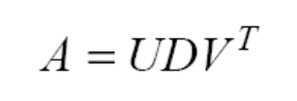
Singular Value Decomposition
The Singular-Value Decomposition (SVD) is a matrix decomposition method for reducing a matrix to its constituent parts in order to make certain subsequent matrix calculations simpler.
Any real m x n matrix A can be decomposed uniquely:
U is m x n and column orthogonal (U^{T}U=I)
D is n x n and diagonal
σ_{i} are called singular values of A
It is assumed that σ₁ ≥ σ₂ ≥ … ≥ σ_{n} ≥ 0
V is n x n and orthogonal (VV^{T}=V^{T}V=I)

Slide 3
SVD (cont’d)
If m=n, then:
U is n x n and orthogonal (U^{T}U=UU^{T}=I)
D is n x n and diagonal
V is n x n and orthogonal (VV^{T}=V^{T}V=I)

Slide 4
SVD (cont’d)
The columns of U are eigenvectors of AA^{T}
The columns of V are eigenvectors of A^{T}A
If λ_{i} is an eigenvalue of A^{T}A (or AA^{T}), then λ_{i =}σ_{i}²

Slide 5


Numerical Problem on SVD
A=
STEP 1: Find A.A’ in order to find U

Slide 6
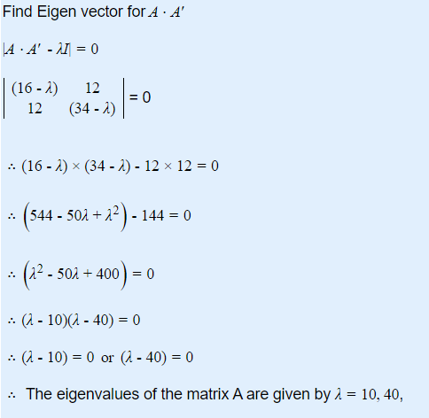
STEP 2: Find Eigen Vector for A.A’
(1)

Slide 7
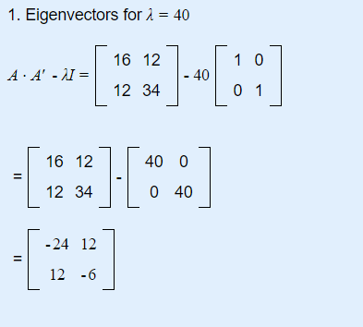
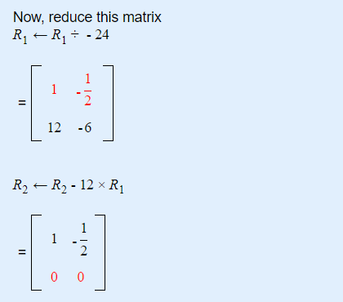
STEP 3: Substitute the value of in (1)

Slide 8
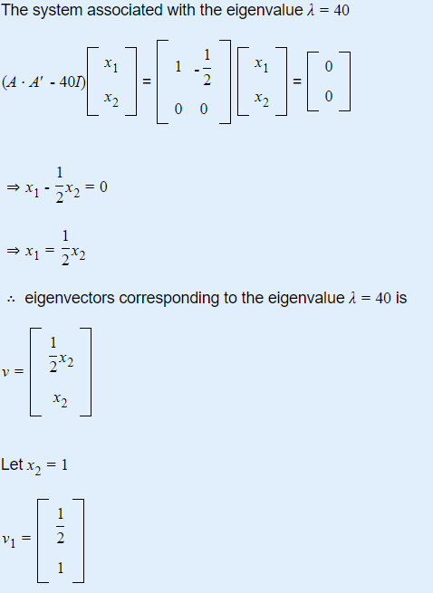

Slide 9
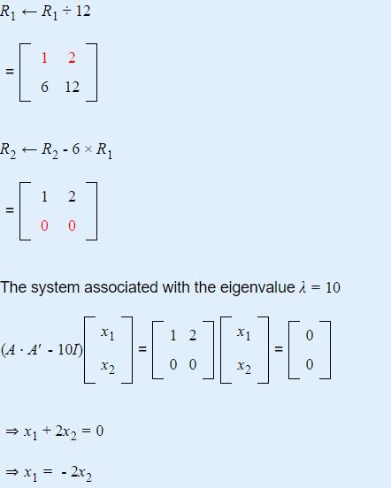
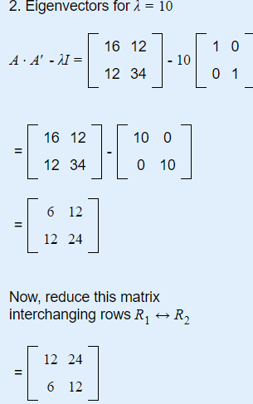

Slide 10
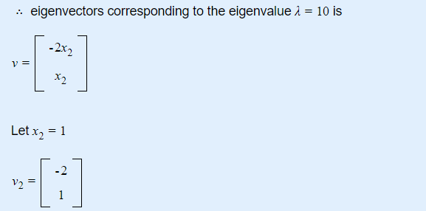
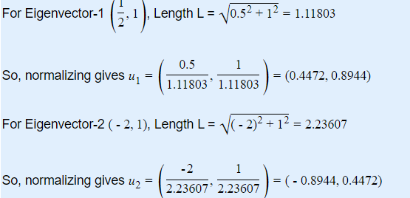

Slide 11
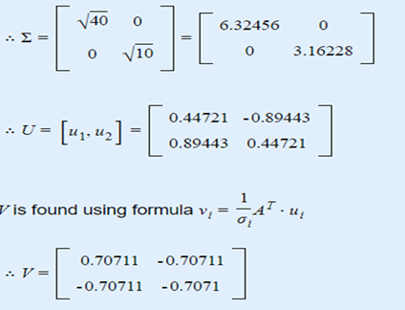
(2)
Firstly take, u1 (column wise)and sigma 1, to find v1
Then take u2 and sigma2 , to find v2

Slide 12
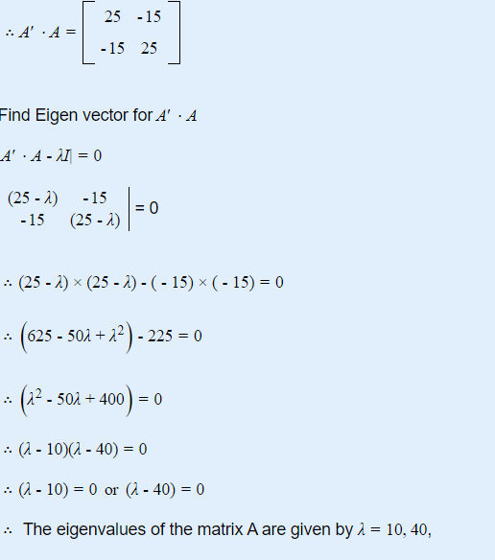
Another Way to find V and U
To Find V using A.A’

Slide 13
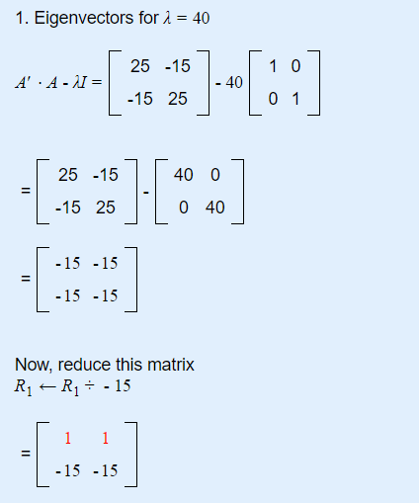
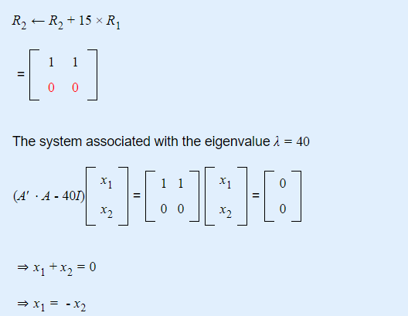

Slide 14
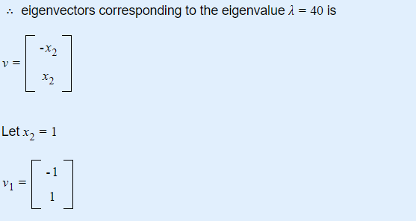

Slide 15
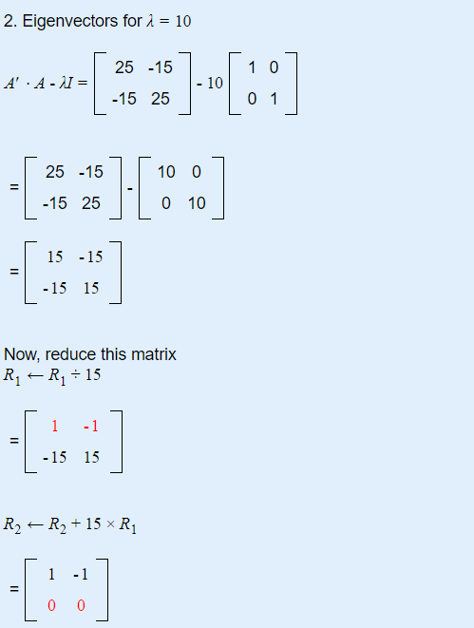
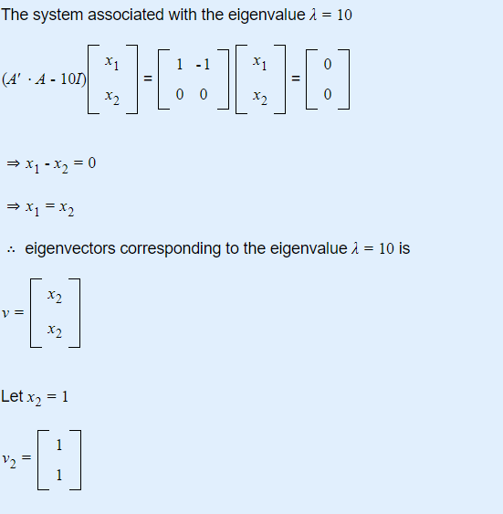

Slide 16
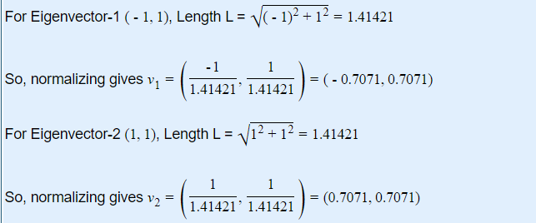

Slide 17
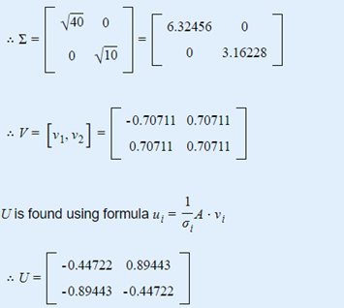

Slide 18
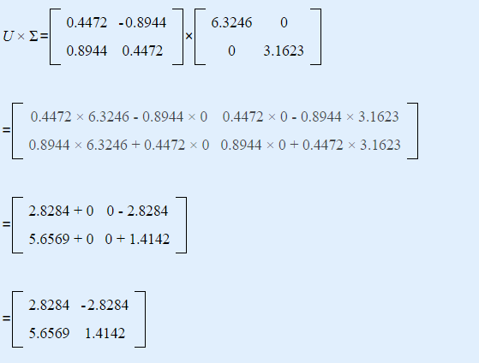
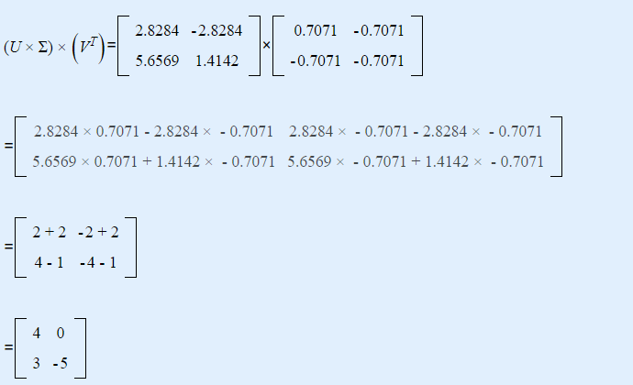
Verification by using first solution

Slide 19
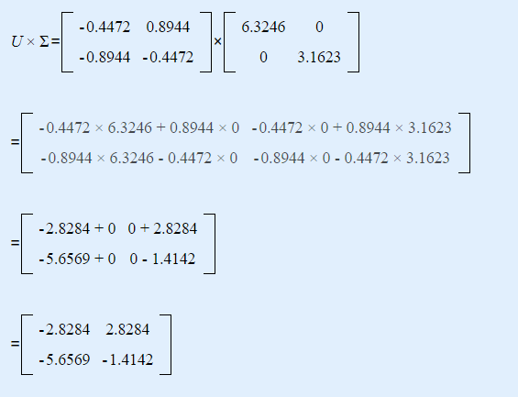
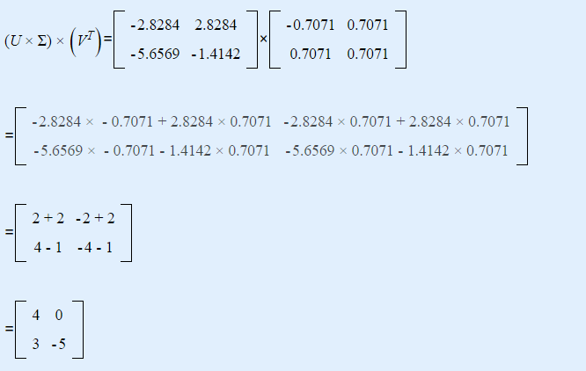
Verification by using second solution

Slide 20
Dimensionality Reduction:
Consider first singular value only and U matrix (i.e. Equation (2))
Projected Data =
0.4472136 -0.89442719
0.89442719 0.4472136
x
6.32456
0
=
2.8284
5.6568

Slide 21
SVD properties
A square (n × n) matrix A is singular iff at least one of its singular values σ₁, …, σ_{n} is zero.
The rank of matrix A is equal to the number of nonzero singular values σ_{i}

Slide 22


